Slide 1
BASH Files and Directories
Scripting Essentials
Dr. Burkman

Slide 2
Helpful student suggestion
Caleb Russell gives this good advice:
I changed a setting for that, so I can use our openSUSE in fullscreen with a nicely stretched image. It was at the top-left of the VMWare window, the VMRC button, Preferences; there's an option in the middle of that Preferences window for VM Window Resize to "Stretch the Virtual Machine in the window.“
Thanks Caleb!

Slide 3
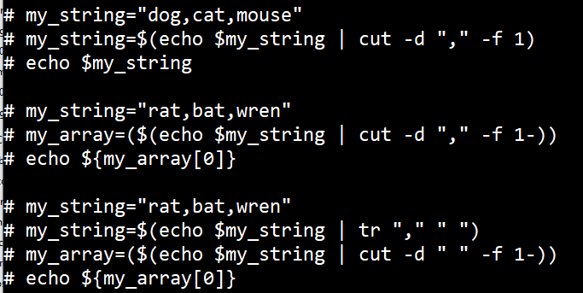
A note on Cut
To make a string to an array you must cut on a space!
Mod 07 Slide 5 shows cutting a string to make an array with delimiters but you can also cut strings by delimiters to make or change strings.
my_string=$(echo $my_string | cut –d “,” -f 1) for example

Slide 4
Basic Linux Commands
rm
Removes a file
rm -r
Removes a directory and everything in it
mkdir
Creates a directory
To make a file readable:
chmod 640 <filename>

Slide 5
“Zipping” in Linux
tar
https://www.gnu.org/software/tar/manual/tar.html
http://www.linfo.org/tar.html
For now:
tar –cf <archive name> <file1> <file2> (makes archive)
tar –cf <archive name> <file1> <file2> -z (makes archive and compresses)
tar –xf filename.tgz (unpacks an uncompressed archive)
tar –xzf filename.tgz (unpacks and decompresses)
tar –xzf filename.tgz -C /target/directory (puts in another directory)

Slide 6
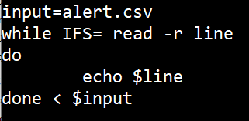
Reading a File
Do not put quotes around path for input!!!!!!
Here I’m also outputting to a file. > is destructive. >> appends.

Slide 7
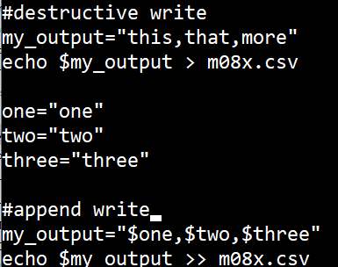
Writing to a File
> will delete the file first if it exists
>> will append to an existing file or make the file if it doesn’t exist

Slide 8
Checking for a file or directory
There is nothing special about the word FILE. Use -d for directory check
FILE=/etc/resolv.conf
if [[ -f "$FILE" ]]; then
echo "$FILE exists."
fi

Slide 9
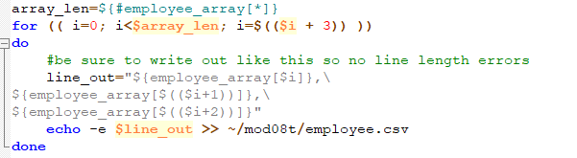
Writing long lines
Writing out and line length errors. Cannot have extra white space after the \

Slide 10
Tutorial
This will all be expanded on in the tutorial. I highly recommend taking your time with it, and making sure that you understand everything. The project is next week!

